Slide 1
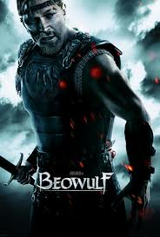
Introduction to The Anglo Saxon Period & Beowulf
Notes:
How does this image compare/contrast with the hero image you and your group created prior to viewing this and beginning Beowulf? (Other than the obvious of actually resembling a human and not a cartoon like stencil image!☺)

Slide 2
Anglo-Saxon Background
British history, culture, and literature was shaped by a series of invaders with varying cultures and languages.
Those invaders were:
Celtic (speaking Gaelic)
Romans (speaking Latin)
Germans – Jutes/Angles/Saxons –called Anglo-Saxons (speaking German)

Slide 3
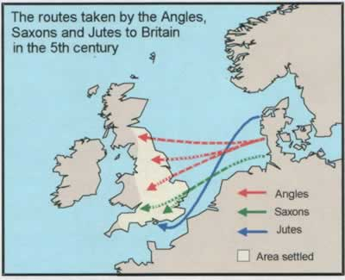
Routes Taken to Britain

Slide 4
New Language
Britain's new language then became Latin + German = Anglo-Saxon/Old English
This is the oldest known form of the language which developed into what we speak today!
Beowulf is the earliest English poem to come to us.

Slide 5
Beowulf: The First Hero
Hero Definition:
A mythological or legendary figure often of divine descent endowed with great strength or ability
An illustrious warrior/one that shows great courage, as in a rescue
A person admired for achievements and qualities

Slide 6
Brief Story Background
Around 700 AD. is when the Anglos, the Saxons, and the Jutes battled the Vikings to take over England. As a result, the best-known hero in the land emerged (Beowulf).
Although Beowulf, the character, was fictitious, the story is based on historical people and made quite a splash in England!
For over 200 years, Beowulf was told over and over again, passed down through the oral tradition (word of mouth) by the storytellers or scops.

Slide 7
Beowulf was The First Text Written in Old English (our language today!)
Sometime before 1000 AD, two unknown scribes wrote down the story of Beowulf in Old English
Only one copy of Beowulf has survived.
It is the oldest surviving epic in British Literature (the English language) (epic: a long narrative poem)

Slide 8
More on the Epic Poem
Characteristics of:
Hero of high rank, noble birth
Hero embodies ideas of society
Performs superhuman deeds
Actions determine fate of a nation
Vast setting
Addresses universal themes
Action begins in medias res (in the middle)
Characters speak in long, formal speeches
Supernatural beings
Reflects timeless values (ex: courage and honor)

Slide 9
More on Beowulf …
Much of the story is based on Celtic and Swedish folk legends.
Since the only people who could read or write during the Dark Ages were priests, and since Beowulf has some Christian elements in it, we assume that the person(s) who wrote the story down was a monk.
Despite Beowulf’s Christian elements, it is still considered a pagan tale (pagan: one who has no religion)

Slide 10
A Few Things to Know Before Reading:
An Anglo-Saxon was to be loyal to his king no matter what. (According to the Anglo-Saxon code of the comitatus, warriors must defend their lord to the death.)
A warrior’s success was measured in gifts from his leader and from fame of doing well in battle.
The Anglo-Saxons believed that “wyrd” or fate controlled lives.
The perfect Anglo-Saxon was supposed to be loyal and brave.

Slide 11
Important Literary Elements
Alliteration:
Repetition of consonant sounds at the beginning of successive words/phrase.
“Tennessee Titans” tangoed to a touchdown.
Peter piper picked a peck of pickles.
Sally sold salads at Subway.

Slide 12
Important Literary Elements
Kenning:
A compound word/phrase that substitutes/takes the place of a specific noun…adds imagery to writing
“sky-candle” = sun
“battle-dew” = blood
“whale-road” = ocean

Slide 13
Metaphor in Beowulf
Kennings and epithets are also metaphorical
“shepherd of evil, guardian of crime”
“Prince of the Weders”
“The Son of Ecgtheow”
“The Geatish hero”
“sky-candle”
“long sleep”
“whale road”
About the Dragon: “thus he moaned his woe,/ alone, for them all, and unblithe wept/ by day and by night, till death’s fell wave/ o’erwhelmed his heart.”
“God must decide/ Who will be given to death’s cold grip.”

Slide 14
Important Literary Elements.
Hyperbole
An exaggeration/overstatement used for effect…to help draw out a comparison or establish an image/idea
Joe was so hungry he could eat a horse.
I have the weight of the world on my shoulders.
I studied for my quiz FOREVER!

Slide 15
Apostrophe
Important Literary Elements.
Directly addressing a someone or something that cannot respond either because it’s not living or is not present/ oftentimes a digression as a sign of desperation

