Slide 1
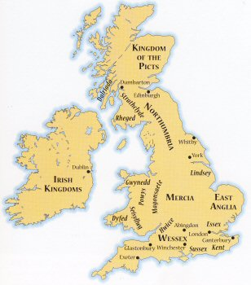
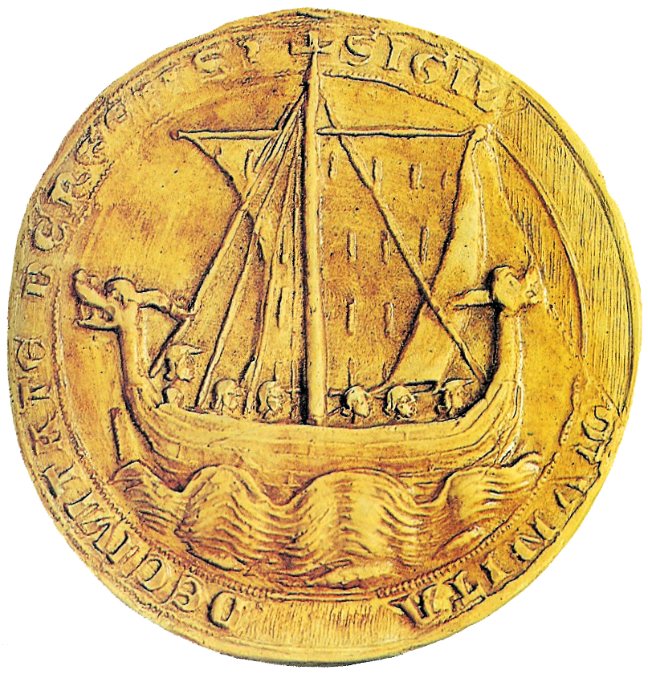
Anglo-Saxon Period
http://www.bing.com/videos/search?q=horrible+histories+anglo+saxon+report&FORM=VIRE1#view=detail&mid=BD12920AC572F1C959E9BD12920AC572F1C959E9

Slide 2
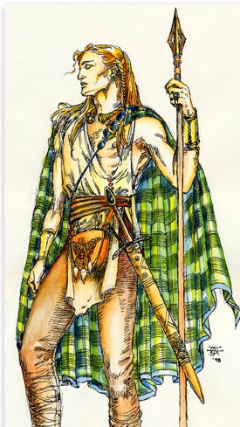
Celtic Invasions
Around 500 BC two groups of Celts invaded British Isles
Brythons (Britons) settled island of Britain
Gaels settled on Ireland
Picts settled in Scotland
Notes:
From about 700 B.C., the Celts dominated most of what is now western and central Europe. Skilled artisans, they introduced the use of iron to the rest of Europe. They also had a highly developed religion, mythology, and legal system that specified individual rights. The Celts were also adept at curing hams, keeping bees, and making wooden barrels. The language of the Celts was dominant in Britain until around the 5th.

Slide 3
Religion – animism (from Latin for “spirit”)
Believed spirits controlled every aspect of life
Druids – priests who settled arguments, presided over religious rituals, and memorized and recited poems about past

Slide 4
Conquered by Romans in the first century A.D. and became part of the Roman Empire.

Slide 5
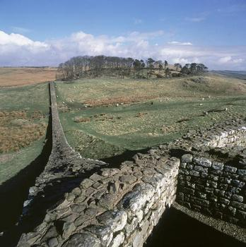
Roman Invasions
55 BC Julius Caesar invaded Britain
43 AD Emperor Claudius invaded; marks beginning of Roman Britain
Celtic religion vanished
Controlled world from Hadrian’s Wall to Arabia
Notes:
Refer to British Isles map in contents pages
Picture of Hadrian's Wall on page 7
The great defensive wall is Hadrian's Wall, which linked the North Sea and the Atlantic near the present-day border between England and Scotland, and held back the marauding Picts and Scots for two hundred years. Along this wall were seventeen large stone forts to house the Roman legions guarding the frontier.

Slide 6
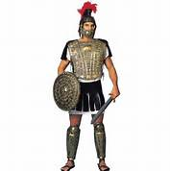
Important Events During Roman Occupation
Romans “leave” in 407 A.D. because Visigoths attack Rome (this leaves Britain defenseless)
St. Augustine (the “other” St. Augustine) lands in Kent in 597 and converts King Aethelbert (King of Kent, the oldest Saxon settlement) to Christianity; becomes first Archbishop of Caterbury

Slide 7
Roman Invasions: What legacy did the Romans leave?
System of roads/highways – height of the empire, one could travel on post roads and use same currency from Northumbria to Middle East; not possible since
Provided an organized society which kept other invaders out for several centuries
Notes:
The 5,000 miles of stone roads the Romans built linked tribal capitals and towns, especially London, York, and Winchester. These roads faciliated trade, the collection of taxes, and the movement of troops.
With the Romans gone and no central government in place, how did this leave the Britains? Vulnerable to outside attacks? Clans fighting for control?

Slide 8
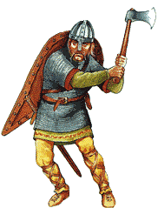

Slide 9
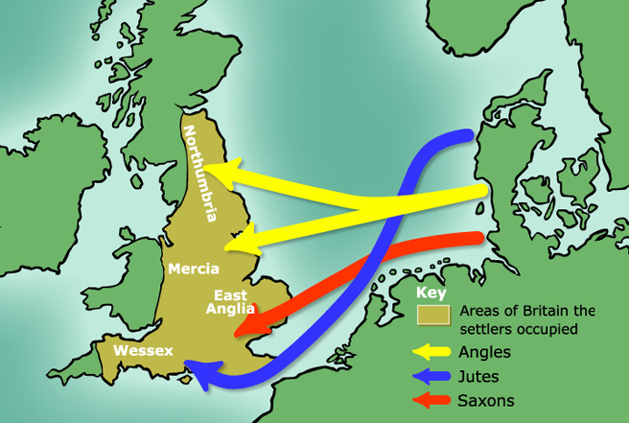
Germanic Invasions - 449
Angles/Saxons from Germany
Jutes from Denmark
Angles, Saxons, and Jutes
Deep sea fishermen and farmers
Britons no match, but didn’t go quietly
King Arthur was probably a Celtic chieftain
Language
Common language now known as Old
English (similar to Dutch and German)
Religion – pagan – similar to Norse mythology
Polytheistic
Notes:
What are some of the names of Anglo-Saxon gods that has survived and still very much part of our daily lives?
Tuesday – from Tiw
Wednesday from Woden
Thursday – chief Teutonic god – Thor – god of thunder
Friday – from Frigga, goddess of the home

Slide 10
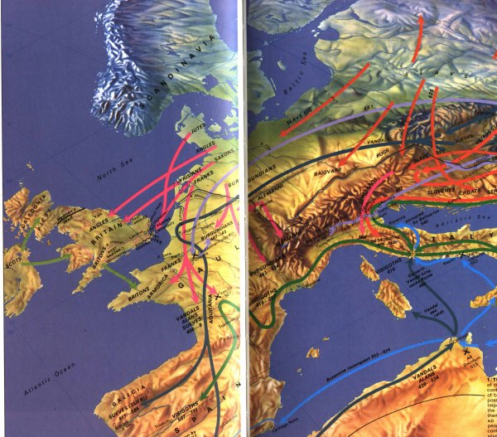
Anglo-Saxons-Jutes

Slide 11
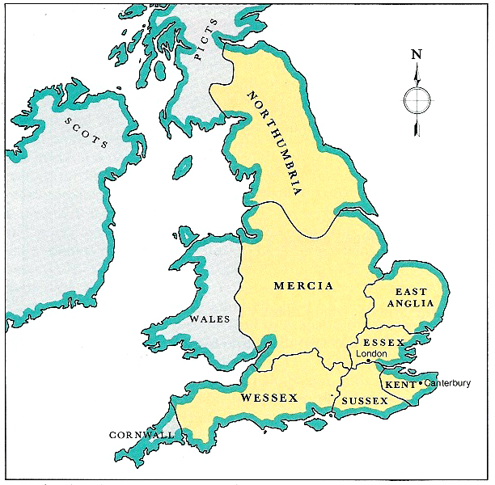
Germanic Invasions - 449
Created the Anglo-Saxon England (“Engla land”) that lasted until 1066
Divided into separate kingdoms: Kent, Northumbria, Mercia and Wessex most important
United themselves in last two centuries to resist invasions from Vikings, or Norsemen (whom they called Danes).
Seven kingdoms of Anglo-Saxon Period: Northumbria, Mercia, Wessex, East Anglia, Essex, Sussex, and Kent

Slide 12
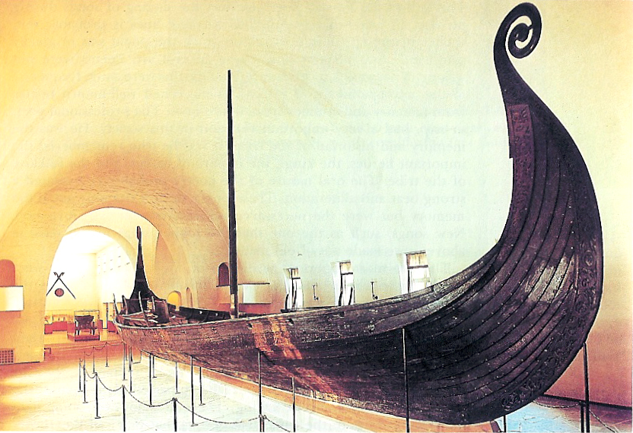
Viking Invasions 8th-12th Centuries
Anglo-Saxons unprepared for ferocity of Vikings
Common prayer: “From the furor of the Norsemen, Oh Lord protect us.”
Viking Ship, known as the Oseberg Ship, dates 825 AD.
Notes:
Viking Ship, known as the Oseberg Ship, dates 825 AD, and is thought to be the burial chamber of Asa, a Viking queen, whose active life belied the passive role women played at this time in history. Married against her will to a Norwegian king, Asa had her husband killed and ruled alone until her death in 850. Accompanying Asa on her voyage to the afterlife was the body of a maidservant, priceless gold and gems (which subsequently were stolen by looters), and objects such as sleds and a wagon. These would permit Asa to travel in the afterlife as much as the Vikings enjoyed traveling while living.
Not a true longboat, this royal barge was tied to a rock before it was buried.
The ship was unearthed in 1904.

Slide 13
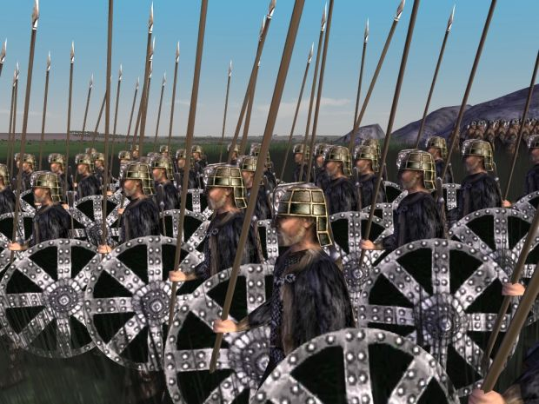
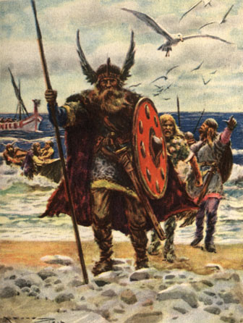
Viking Invasions 8th-12th Centuries
Vikings destroyed monasteries and sacred object
Slaughtered everyone in settlements that couldn’t pay enough to them
King Alfred of Wessex (871-899) forced Vikings to northern England
Danelaw – dividing line between Viking Britain and Anglo-Saxon Britain

Slide 14
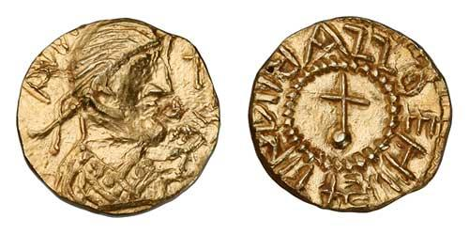
Anglo-Saxon Period
“Anglo-Saxon England was born of warfare, remained forever a military society, and came to its end in battle.” - J. R. Lander
In a society dominated by aggression, what would you expect to be the Anglo-Saxon attitude toward family life, the role of women, art, literature, ethics and work?

Slide 16
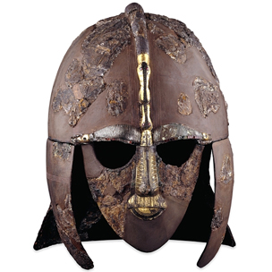
Anglo-Saxon Period: 449-1066
Characteristics of the Period
Enormous upheaval and change in England
Reigns of some of the most famous and infamous kings
Time of disastrous wars, both internal and external
Time of foreign invasion
Time of painful reconsolidation and emergence of England as nation

Slide 17
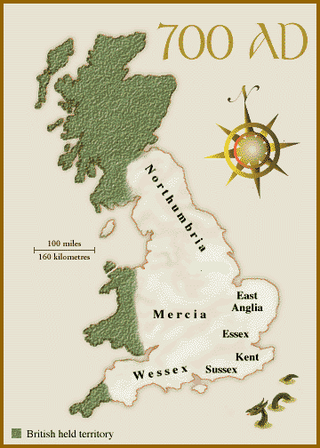
Nine Anglo-Saxon Kingdoms eventually become the Anglo-Saxon heptarchy (England not unified) or “Seven Sovereign Kingdoms”.

Slide 18
Anglo-Saxon Civilization
Common language
Shared a heroic ideal; set of traditional heroes
Admired men of outstanding courage
Loyalty to leader and tribe
Fierce personal valor

Slide 19
Anglo-Saxon Civilization
Persons of rank received with grave courtesy
Ruler generous to those who remain loyal
Everyone aware of shortness of life & passing of all things in the world
Impersonal, irresistible fate determined most of life (Wyrd or Fate)
Heroic human will & courage allowed individuals to control their own response to fate
Notes:
As a resut, they would win fame and become models for others?
What does the word stoic mean?
How do you think stoicism will play into literature?

Slide 20
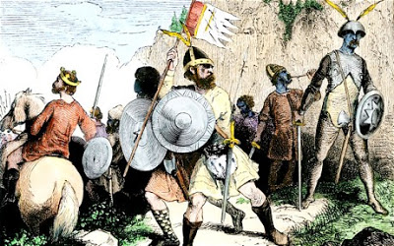
Social Order
Heroic groups; rural and tribal
Core of culture was comitatus relationship-warrior bond for each other and their leader. Tribes engaged in blood feuding constantly.
WER GELD= “man price,” absolute obligation to avenge a fellow warrior’s death (like gangs).
After battles, there was a strict payment of treasure.
Chief selected for loyalty, generosity, strength, and courage.

Slide 21
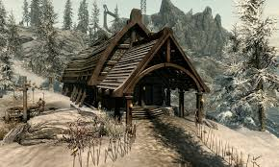
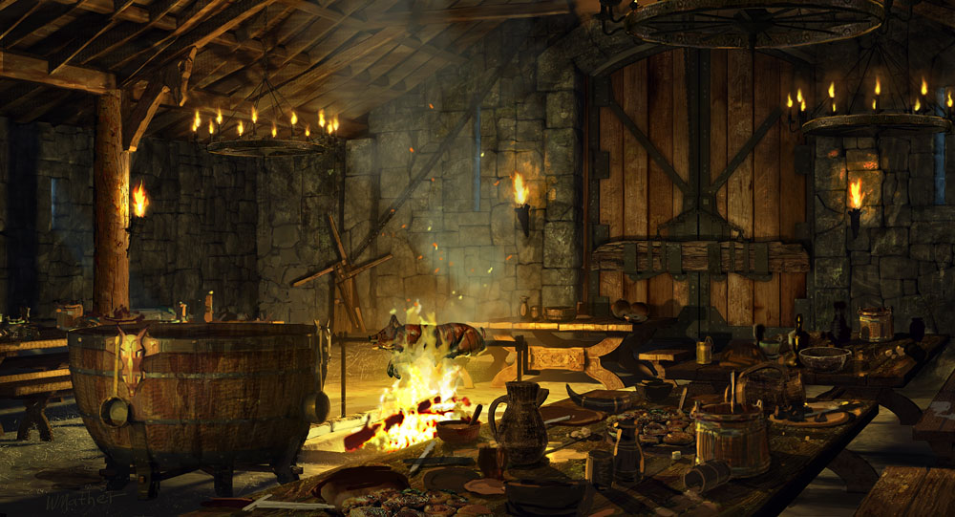
Village life centered on the mead hall.
Mead: fermented beverage made from honey.
Thanes: soldiers loyal to the king
Flagon: cup
Entertainment: singers (gleeman), scop (poet)

Slide 22
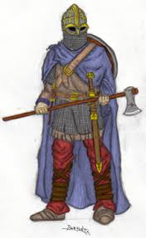
What was valued by the Anglo-Saxons?
TRAITS
athletic violent
strong warrior
seafaring ruthless
adventurous
fair play

Slide 23
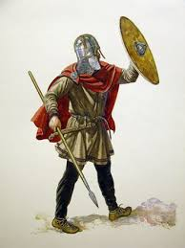
The Ideals of the Anglo-Saxons
Repression of sentiment
Allegiance to lord/king
Love of personal freedom
Comitatus relationship
Respect for women
Love of glory
Honored the truth

Slide 24
Creating an Anglo-Saxon Army

Slide 25
Creating an Anglo-Saxon
Must have basic stick man body, head, etc.
Must show as many qualities of an Anglo-Saxon as you feel you can show.
Must have a name.
Must be labeled.
Must have color.

Slide 26
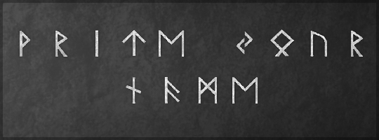
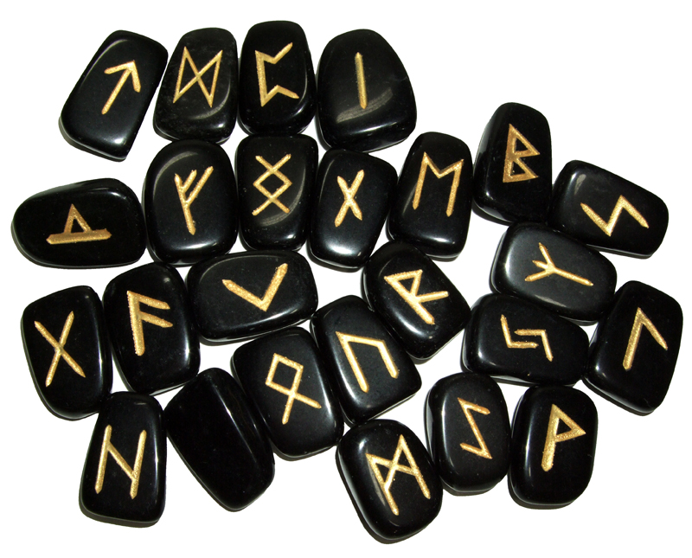
http://www.pbs.org/wgbh/nova/ancient/write-your-name-in-runes.html
Runes were used by early Germanic tribes on documents in stone, wood and metal. They relied on these symbols not only for writing but also to tell fortunes, cast spells, and provide protection.
The runic alphabet, or Futhark, gets its name from the first six sounds, much like our alphabet “A,B,C’s”.

Slide 27
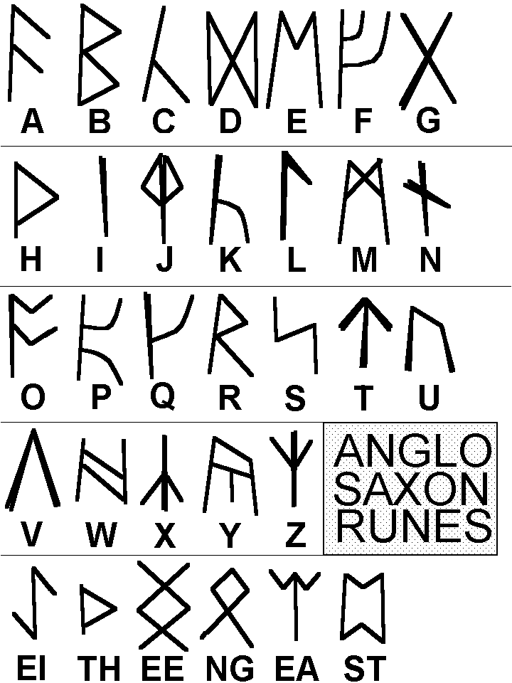

Slide 28
Anglo-Saxon Literature
Oral tradition – poems and song committed to memory and performed by scops, bards, gleemen, or minstrels
With coming of Christian Church, written literature began to evolve
Two important traditions in literature
heroic tradition – celebrates heroes
elegiac tradition – passing of earlier, better
times

Slide 29
Anglo-Saxon Literature
Beowulf – one of few pieces that survived. Priests and monks were the only ones who could write; stories survival depended upon them. The church was not too eager to preserve literature that was pagan in nature, so historians believe they either ignored it or changed it. This may account for the mixture of Christian and pagan elements in Beowulf.

Slide 30
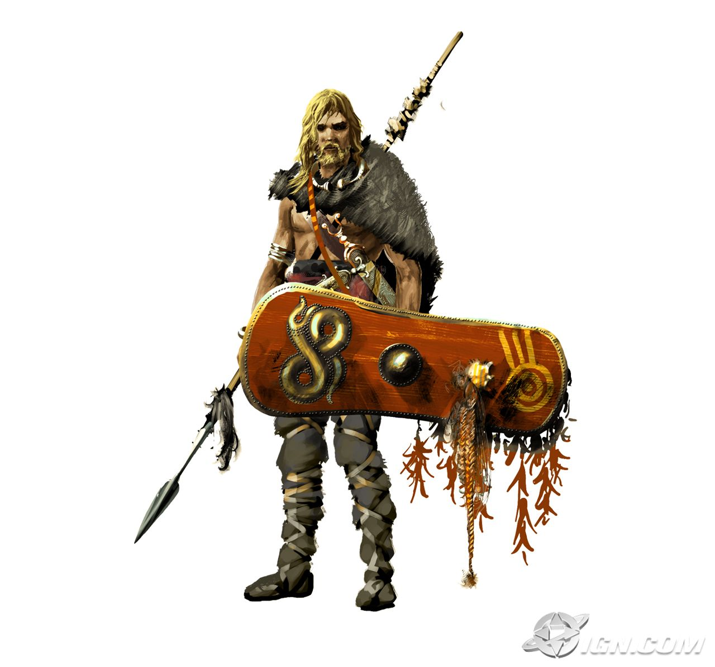
Anglo-Saxon Literature
Beowulf: England:: Iliad and Odyssey : Greece
Oral art – handed down with changes and embellishments
Composed in Old English probably in Northumbria in northeast England sometime between 700-750
Depicts a world from the early 6th century

Slide 31
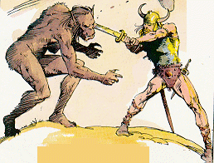
Anglo-Saxon Literature
Poem based on early Celtic and Scandinavian folk legends
Scenery described is from Northumbria; assumed that poet was Northumbrian monk
Only manuscript available dates from the year 1000; discovered in the 18th century

Slide 32
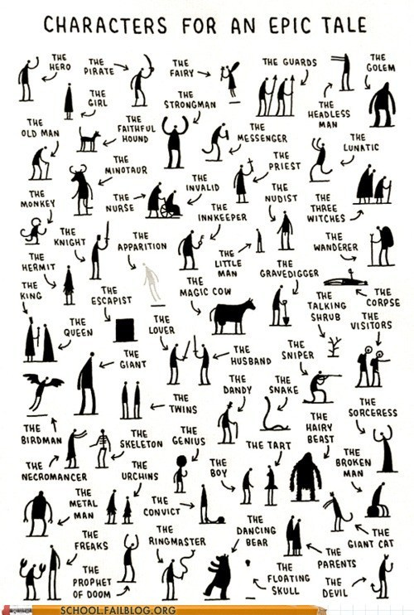
The Epic
A long narrative poem on a great and serious subject, related in an elevated style, and centered on a heroic or quasi-divine figure on whose actions depends the fate of a tribe, a nation, or the human race.

Slide 33
Epic Conventions
The hero is of great national cosmic importance, the ideal man of his culture. He often has superhuman or divine traits. He has an imposing physical stature and is greater than the common man.
The setting is vast. It covers great distances, perhaps even visiting the underworld, other worlds, other times.
The action consists of deeds of valor or superhuman courage (especially in battle).
Supernatural forces interest themselves in the action and intervene at times.
The style of writing is elevated, even ceremonial.

Slide 34
Old English Poetics
Alliteration – repetition of consonant and vowel sounds at the beginning of words
Caesura – a natural pause or break in the middle of the line of poetry and joined by the use of a repeated vowel or consonant sound
Out of the marsh // from the foot of misty
Hills and bogs // bearing God’s hatred
Grendel came // hoping to kill
Anyone he could trap // on this trip to high Herot

Slide 35
Old English Poetics
Kennings – a metaphorical phrase used to replace a concrete noun. Ready made descriptive compound words that evoke vivid images
Kennings are formed by
prepositional phrases
possessive phrases
compound words
Preposition phrase – Giver of knowledge
Possessive phrase – mankind’s enemy
Compound word – sea path

Slide 36
Anglo-Saxon Poetry and Riddles The Book of Exeter
Contains more than 30 poems and 90 riddles.
Written down by monks in about 975, our primary source of Anglo-Saxon poetry
Dominant mood in poetry is elegiac, or mournful
Dominant tone of riddles is light and somewhat bawdy

Slide 37
Overview of English Influences Pre-History-1066 A.D. C.R.A.V.N.
Celts (Brythons and Gaels) up to 55 B.C.
Roman Conquest 55 B.C. - 407 A.D.
Anglo-Saxon Period 407 A.D. - 787 A.D.
Viking Invasions 787 A.D. - 1066 A.D.
Noman Conquest begins in 1066 A.D.

Slide 38
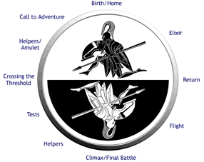
Characteristics of Epic Hero
Is significant and glorified
Is on a quest
Has superior or superhuman strength, intelligence, and/or courage
Is ethical
Risks death for glory or for the greater good of society
Performs brave deeds
Is a strong and responsible leader
Reflects the ideals of a particular society

